Slide 1
Unit-1
SEARCHING AND SORTING

Slide 2
Contents…
Searching
  Searching
  Importance of Searching
  Types of searching
    Sequential search
    Binary search
Sorting
  Basics of sorting
  Types of sorting
    Selection sort
    Insertion sort
    Merge sort
    Radix sort

Slide 3
What is a Searching?
Searching in data-structure refers to the process of finding a desired element in set of items.
The desired element is called "target".
The set of items to be searched in any data-structure like − list, array, linked-list, tree or graph.
Search refers to locating a desired element in a collection of items.
Any search is successful or unsuccessful depending upon whether the element that is being searched is found or not.
  Element is found- search is successful
  Element is not found- search is unsuccessful

Slide 4
Types of Searching
Linear or sequential search
Binary search

Slide 5
Linear search
Searching of specific element in given array is linear.
Linear search is also called as sequential search algorithm.
We access each element of an array one by one sequentially and see whether it is desired element or not.
It compares the target element with all the elements sequentially in an array to find if the element is present in the list or not.
It starts searching from beginning of array until required element is not found.
If the match is found, then the location of the item is returned; otherwise, the algorithm returns NULL.

Slide 6
Linear Search
Algorithm:
Step 1: Traverse the array elements using a for loop.
Step 2: Match/compare the key element with array element.
Step 3: If key element is found, return the index position of array element.
If key element is not found, then move to the next element.
Step 4: If there is no match or key element is not present in the given array, return -1 or Null.

Slide 7
Linear Search
It implements on unsorted or unordered list.
It is widely used to search an element from the unordered list.
The time complexity of linear search
  The Best-case time complexity is O(1).
  The Average-case time complexity is O(n).
  The worst-case time complexity is O(n).

Slide 8
Linear Search Algorithm
Steps:
1. i=0
2. if i>n; go to step 7
3. if A[i]=x; go to step 6
4. i=i+1
5. Go to step 2
6. Print x found at location I
7. Print element not found
8. Exit

Slide 9
Binary Search
Binary Search is a searching algorithm used in a sorted array.
Binary search works efficiently on sorted lists by repeatedly dividing given array.
Binary search follows the divide and conquer approach.
Array/list is divided into two halves, and the item is compared with the middle element of the list.
If the match is found then, the location of the middle element is returned otherwise, we search into either of the halves.

Slide 10
Working of Binary Search
It searches the given element in minimum possible comparisons.
In this searching, first we need to sort the array in ascending order.
Operations-
  First find the middle element of the array.
  Compare the mid element with an item/desired element.
  There are three possible cases-
    If mid element is a desired element, then search is completed.
    If mid element is greater than desired element, then search only in first half of array.
    If mid element is less than desired element, then search only in second half of array.

Slide 11

Binary Search Example
A=
Search element X=31 in given array A.

Slide 12
Binary Search Example
A=
Search element X=31
low=0, high=9
step low high mid A[mid] X
1 0 9 4 27 < 31
2 5 9 7 35 > 31
3 5 6 5 31 = 31 element found

Slide 13
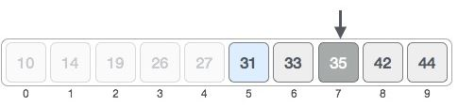

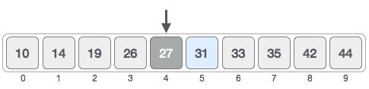
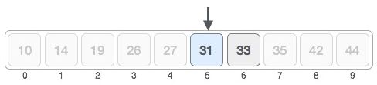


Eg 3
low high mid A[mid] X
1. 0 9 4 27 < 31
3. 5 9 7 35 > 31 4
5. 5 6 5 31 = 31 found
1 5
2 6

Slide 14
Algorithm
Step 1: Set beg = lower_bound, end = upper_bound
Step 2: Repeat steps 3 and 4 while beg <=end
Step 3: Set mid = (beg + end)/2
Step 4: if a[mid] =item
Set pos = mid
print pos go to step 6
else
if a[mid] > item
set end = mid -1
else
set beg = mid + 1
Step 5: if a[mid] != item
print “Item is not present in the array"
Step 6: exit

Slide 15
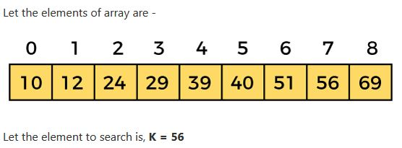
Example

Slide 16
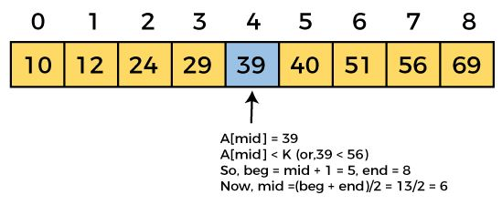
beg=0, end=8, mid=(beg+end)/2
mid = (0 + 8)/2 = 4. So, 4 is the mid of the array.

Slide 17
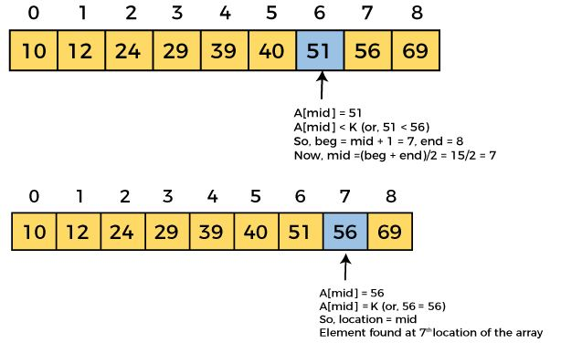

Slide 18
Binary Search complexity
Time Complexity
Best Case Time Complexity is O(1)
The element to search is found in first comparison
Average Case Time Complexity is O(logn)
The average case time complexity of Binary search
Worst Case Time Complexity is O(logn)
We have to keep reducing the search space till it has only one element.

Slide 19
Sorting
Sorting refers to arranging data in a particular format.
Sorting algorithm specifies the way to arrange data in a particular order.
Examples of sorting in real-life scenarios −
  Telephone Directory
  Dictionary
Increasing Order
  In a sequence of values, if the successive element is greater than the previous one.
Decreasing Order
  In a sequence of values, if the successive element is less than the current one.

Slide 20
Types of Sorting
Types of sorting
  Selection sort
  Insertion sort
  Merge sort
  Radix sort

Slide 21
Selection sort
Selection sort is a simple sorting algorithm.
This sorting algorithm is an in-place comparison-based algorithm
In this algorithm, the array is divided into two parts,
  the sorted part at the left end and
  the unsorted part at the right end.
Initially, the sorted part is empty.
The unsorted part is the entire given array.
The smallest element is repeatedly selected from the unsorted array and swapped with the leftmost element.

Slide 22
Working of Selection sort
In selection sort,
  Select the first smallest element from the unsorted array.
  Place the smallest element at the first position by swapping the smallest element with the first element.
  Traverse the unsorted array and select the second smallest element.
  Place it in the second position by swapping it with second element.
  The process continues until the array is entirely sorted in ascending order.

Slide 23

Selection sort Example
Consider the following array and sort it.

Slide 24




Example
At present, 14 is stored at the first position, traverse the entire array, 10 is the smallest value.
Swap 14 with 10. 10 will appear at the first position in the sorted array.
Traverse the unsorted array, 14 is the next smallest value.
Swap 33 with 14. 14 will appear at the second position in the sorted array.

Slide 25
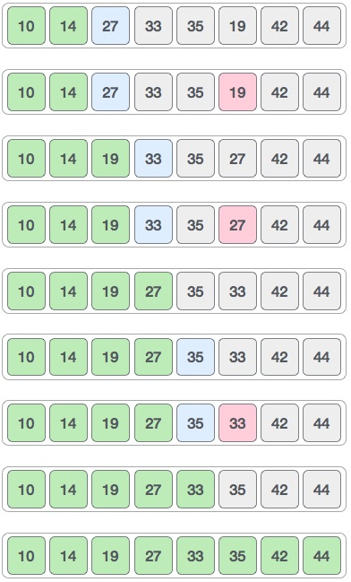
Traverse the unsorted array, 19 is the next smallest value.
Swap 27 with 19. 19 will appear at the third position in the sorted array.
Traverse the unsorted array, 27 is the next smallest value.
Swap 33 with 27. 27 will appear at the fourth position in the sorted array.
The same process is applied to the rest of the array elements until array is sorted.

Slide 26
Algorithm
Selection sort algorithm uses following steps:
Step 1 − Set MIN to location 0
Step 2 − Search the minimum element in the array
Step 3 − Swap with value at location MIN
Step 4 − Increment MIN to point to next element
Step 5 − Repeat until array is sorted

Slide 27
Selection sort Time complexity
Time Complexity
Best Case Time Complexity is O(n²)
Average Case Time Complexity is O(n²)
Worst Case Time Complexity is O(n²)

Slide 28
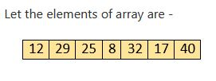

Example
Sorted array is

Slide 29
Insertion Sort
This is an in-place comparison-based sorting algorithm.
Insertion sort works similar to the sorting of playing cards in hands.
Array is maintained as sorted and unsorted array.
Insertion sort idea-
  Take the first element as sorted in the array.
  Then select next/second an unsorted element.
  Compare both element.
  If the selected second unsorted element is greater than the first element, it will be placed at the right side; otherwise, it will be placed at the left side.
  Similarly, all unsorted elements are taken and put in their exact place.

Slide 30
Insertion Sort
An element which is to be 'insert'ed in sorted array, has to find its appropriate place and then it has to be inserted there.
Hence it is called as insertion sort.
The array is searched sequentially and unsorted items are moved and inserted into the sorted array.
Example
Sort the following array using Insertion sort technique.

Slide 31
Working of Insertion Sort
Steps used by insertion sort.
Step 1 − If it is the first element, it is already sorted. return 1;
Step 2 − Pick next element
Step 3 − Compare with all elements in the sorted array
Step 4 − Shift all the elements in the sorted array that is greater than the value to be sorted
Step 5 − Insert the value
Step 6 − Repeat until list is sorted

Slide 32



Insertion sort compares the first two elements.
It finds that both 14 and 33 are already in ascending order.
14 is in sorted array.
Insertion sort moves ahead and select and compares 33 with 27.
It finds that 33 is greater than 27. It swaps 33 with 27.
It also checks with all the elements of sorted array.
The sorted array has only one element 14, and 27 is greater than 14. Hence the sorted array remains sorted after swapping.

Slide 33





It compares 33 with 10. 33 is greater than 10.
So we swap 33 with 10.
10 is also checks with all the elements of sorted array.
The sorted array have two elements 14 and 27 which are greater than 10.
Hence put 10 at first position after swapping with 27 and 14.

Slide 34

This process goes on until all the unsorted elements are covered in a sorted array.
Example
Sorted array is

Slide 35
Insertion sort Time complexity
Time Complexity
Best Case Time Complexity is O(n)
Average Case Time Complexity is O(n²)
Worst Case Time Complexity is O(n²)

Slide 36
Merge sort
Merge sort is the sorting technique that follows the divide and conquer approach.
Merge sort first divides the array into two equal halves and then combines them in a sorted manner.
The sub-arrays are divided again and again into halves until
  the array cannot be divided further.
  it has only one element left, then dividing will stop.
It is a recursive algorithm that continuously splits the array in half until it cannot be further divided.

Slide 37
Merge Sort
Then we combine the pair of one element array into two-element array, sorting them and merge.
The sorted two-element pairs is merged into the four-element array, and so on until we get the sorted list.
Merge operation is the process of taking two smaller sorted arrays and combining them to eventually make a larger one.

Slide 38
Merge sort Steps
Step 1 - Declare left variable to 0 and right variable to n-1
    if it is only one element in the array it is already sorted, return.
Step 2 - Find mid by medium formula. mid = (left+right)/2
Step 3 - Divide the array into two halves.
Step 4 - Again divide the array recursively into halves until it can no more be divided.
    Call merge sort on (left, mid)
    Call merge sort on (mid+1, right)
Step 5 - Merge the smaller arrays into new array in sorted order by calling merge function.

Slide 39




Merge sort Example
Given Array Array Size=8
Divide Array Size=4
Divide Array Size=2
Divide Array Size=1
We can not divide array further.

Slide 40


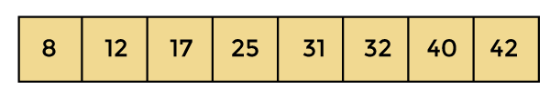
Merge sort Example
Sort & Merge Array Size=1
Sort & Merge Array Size=2
Sort & Merge Array Size=4
Sort & Merge Array Size=8
Now, the array is completely sorted.

Slide 41
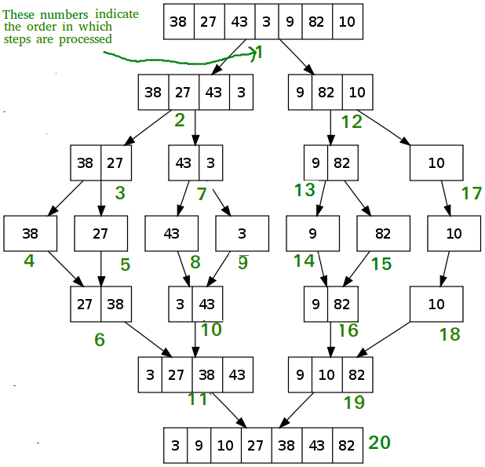
Example
Once the size of array becomes 1, the merge processes come into action and start merging arrays back till the complete array is merged.

Slide 42
Merge sort Time complexity
Best Case Time Complexity – O(n*logn)
If no sorting required, i.e. the array is already sorted.
Average Case Time Complexity –O(n*logn)
If array elements are in jumbled order that is not properly ascending and not properly descending.
Worst Case Time Complexity – O(n*logn)
If array elements are required to be sorted in reverse order.

Slide 43
Radix Sort
Radix sort is the linear sorting algorithm that is used for integers.
In Radix sort, digit by digit sorting is performed.
Sorting is started from the least significant digit to the most significant digit.
Radix sort is a non-comparative sorting algorithm that is better than the comparative sorting algorithms.
The process of radix sort works similar to the sorting of students names, according to the alphabetical order.

Slide 44
Radix sort steps
First, find the largest element (max) from the given array.
Suppose 'x' be the number of digits in max.
The 'x' is calculated because we need to go through the significant places of all elements.
After that, go through one by one each significant place.
Here, we have to use any stable sorting algorithm to sort the digits of each significant place.

Slide 45

Radix Sort Example
In the given array,
the largest element is 802 that have 3 digits in it.
Three passes are required to sort the array.

Slide 46




Pass 1:
Array is sorted on the basis of the digits at 0's place.
After the first pass, the array elements are –
Pass 2:
Array is sorted on the basis of the next significant digits at 10th place.
After the second pass, the array elements are –

Slide 47

Pass 3:
Array is sorted on the basis of the next significant digits at 100th place.
After the third pass, the array elements are –
Now the array is sorted–

Slide 48
Radix sort Time complexity
Best Case Time Complexity – Ω(n+k)
If no sorting required, i.e. the array is already sorted.
Average Case Time Complexity – θ(nk)
If the array elements are in random order that is not properly ascending and not properly descending.
Worst Case Time Complexity – O(nk).
If the array elements are required to be sorted in reverse order.

Slide 49

Radix Sort Example
In the given array,
the largest element is 736 that have 3 digits in it.
Three passes are required to sort the array.

Slide 50
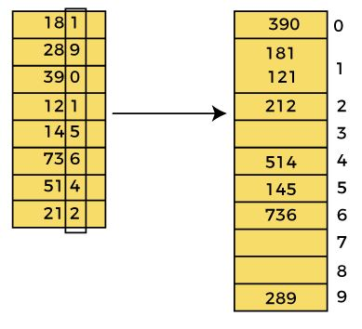

Pass 1:
In the first pass, the array is
sorted on the basis of the
digits at 0's place.
After the first pass, the array elements are -

Slide 51
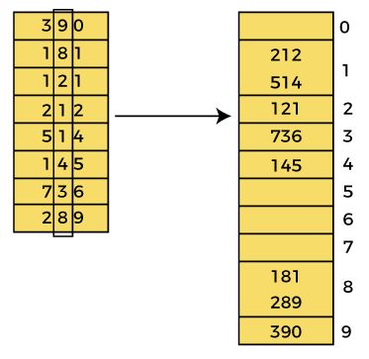

Pass 2:
In the second pass, the array
is sorted on the basis of the
next significant digits at 10th
place.
After the second pass, the array elements are -

Slide 52
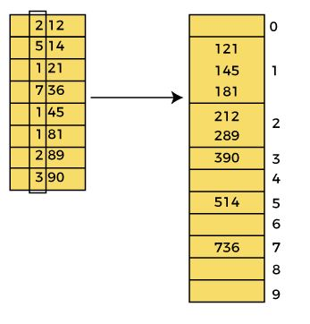

Pass 3:
In the third pass, the array
is sorted on the basis of the
next significant digits at 100th
place.
After the third pass, the array elements are -

Slide 53
End of Unit-1

